Slide 1
Bayesian Classifier and its variants
Chapter 02
Ref. Book: Pattern Recognition – S. Theodoridis
Rakib Mahmud
Lecturer, BUBT

Slide 2
Classifier based on Bayes Decision theory
Statistical nature of feature vectors
x = [x , x ,...,x ]
T
1 2 l
Assign the pattern represented by feature vector to the most probable of the available classes
ω₁,ω₂ ,...,ω_{M}
x → ω_{i} : P(ω_{i} x)
That is
Maximum

Slide 3
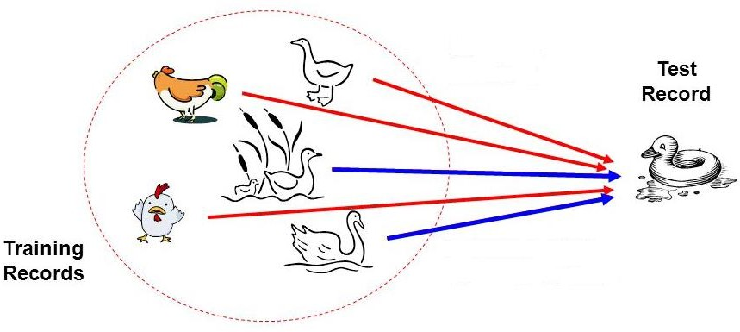
Bayesian Classifier
Principle
If it walks like a duck, quacks like a duck, then it is
probably a duck

Slide 4
Bayesian Classifier
A statistical classifier
  Performs probabilistic prediction, i.e., predicts class membership probabilities
Foundation
  Based on Bayes’ Theorem.
Assumptions
  The classes are mutually exclusive and exhaustive.
  The attributes are independent given the class.
Called “Naïve” classifier because of these assumptions
  Empirically proven to be useful.
  Scales very well.

Slide 5

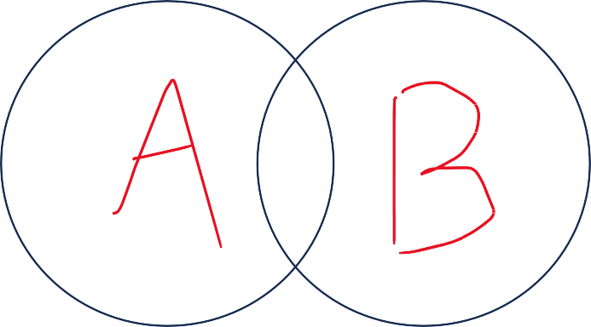
Mutually Exclusive and Exhaustive events
Mutually exclusive
Events they do not have any outcomes in common
Disjoint
P(A∩B)=0
Mutually Exclusive
Mutually not Exclusive

Slide 6
Mutually Exclusive and Exhaustive events
Mutually exclusive
Event: Dice (36 sample spaces)
Event A: P(at least one 5)
Event B: P(sum<4)
Mutually exclusive?
Mutually Exclusive
Mutually not Exclusive

Slide 7
Mutually Exclusive and Exhaustive events
Mutually exclusive
Event: Dice (36 sample spaces)
Event A: P(at least one 5)
Event B: P(sum<4)
Mutually exclusive?
YES
Mutually Exclusive
Mutually not Exclusive

Slide 8

Mutually Exclusive and Exhaustive events
Exhaustive Events
Events that contain all the outcomes of sample space
P(A∪B)=1
Not Exhaustive
Exhaustive

Slide 9
Mutually Exclusive and Exhaustive events
Exhaustive Events
Event: Dice (36 sample spaces)
Event A: P(at least one 6)
Event B: P(sum<11)
Not Exhaustive
Exhaustive

Slide 10
Mutually Exclusive and Exhaustive events
Mutually Exclusive + Exhaustive Events
When exhaustive events don’t overlap, they become mutually exclusive! Any example?
Not Exhaustive
Exhaustive

Slide 11
Bayesian Classifier Examples
Example 01
Given:
A doctor knows that meningitis causes stiff neck 50% of the time
Prior probability of any patient having meningitis is 1/50000
Prior probability of any patient having stiff neck is 1/20
Question: If a patient has stiff neck, does he/she has meningitis?

Slide 12
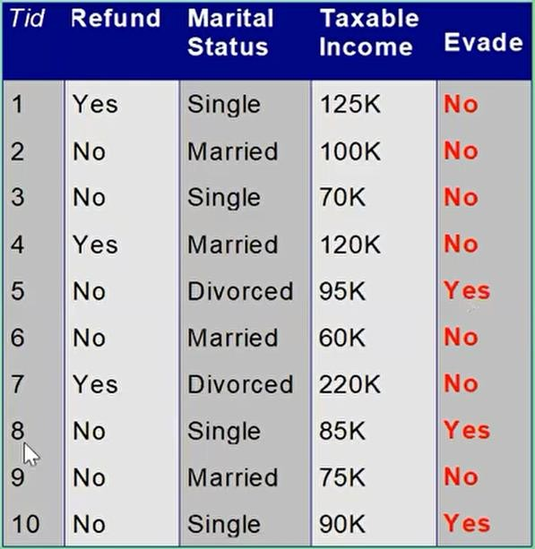
Bayesian Classifier Examples
Example
A married person with income 120k did not refund
the loan previously
Can we trust him?

Slide 13
Bayesian Classifier Examples
Example 03
The sea bass/salmon example
We now the previous counts of salmon/sea bass
Can we predict which fish is coming in the conveyor?

Slide 14
Bayesian Classifier
In many applications, the relationship between the attributes set and the class variable is non- deterministic.
  In other words, a test cannot be classified to a class label with certainty.
  In such a situation, the classification can be achieved probabilistically.
The Bayesian classifier is an approach for modelling probabilistic relationships between the attribute set and the class variable.
More precisely, Bayesian classifier use Bayes’ Theorem of Probability for classification.
Before going to discuss the Bayesian classifier, we should have a quick look at the Theory of Probability and then Bayes’ Theorem.

Slide 15
Simple probability
If there are n elementary events associated with a random experiment and m of n of them are favorable to an event A, then the probability of happening or occurrence of A is
𝑚
𝑃 𝐴 = _{𝑛}

Slide 16

Simple probability
If there are n elementary events associated with a random experiment and m of n of them are favorable to an event A, then the probability of happening or occurrence of A is
𝑚
𝑃 𝐴 = _{𝑛}
Suppose, A and B are any two events and P(A), P(B) denote the probabilities that the events A
and B will occur, respectively.
Mutually Exclusive Events: Two events are mutually exclusive, if the occurrence of one precludes the occurrence of the other.
Example: Tossing a coin (two events) Tossing a ludo cube (Six events)
Can you give an example, so that two events are not mutually exclusive?
Hint: Tossing two identical coins, Weather (sunny, warm)

Slide 17
Simple probability
Independent events: Two events are independent if occurrences of one does not alter the occurrence of other.
Example:
Tossing both coin and ludo cube together.
(How many events are here?)
Can you give an example, where an event is dependent on one or more other events(s)?
Hint: Receiving a message (A) through a communication channel (B)
over a computer (C), rain and dating.

Slide 18
Joint probability
If P(A) and P(B) are the probability of two events, then
𝑃 𝐴 ∪ 𝐵 = 𝑃 𝐴 + 𝑃 𝐵
− 𝑃 𝐴 ∩ 𝐵
If A and B are mutually exclusive, then 𝑃 𝐴 ∩ 𝐵 = 0
If A and B are independent events, then 𝑃 𝐴 ∩ 𝐵 = 𝑃 𝐴 . 𝑃(𝐵)
Thus, for mutually exclusive events
𝑃 𝐴 ∪ 𝐵 = 𝑃 𝐴 + 𝑃 𝐵

Slide 19
Conditional probability
If events are dependent, then their probability is expressed by conditional probability. The probability that A occurs given that B is denoted by 𝑃(𝐴|𝐵).
Suppose, A and B are two events associated with a random experiment. The probability of A
under the condition that B has already occurred and 𝑃(𝐵) ≠ 0 is given by
𝑃(𝐴 ∩ 𝐵)
𝑃 𝐴 𝐵 =
𝑃(𝐵)

Slide 20
Conditional probability
𝑃 𝐴 ∩ 𝐵
𝑃 𝐴 ∩ 𝐵
= 𝑃 𝐴 . 𝑃 𝐵 𝐴 ,
𝑖𝑓 𝑃 𝐴 ≠ 0
𝑖𝑓 𝑃(𝐵) ≠ 0
or
= 𝑃 𝐵 . 𝑃 𝐴 𝐵 ,
For three events A, B and C
For n events A₁, A₂, …, A_{n} and if all events are mutually independent to each other
𝑃 𝐴₁ ∩ 𝐴₂ ∩ … … … … ∩ 𝐴_{𝑛} = 𝑃 𝐴₁ . 𝑃 𝐴₂ … … … … 𝑃 𝐴_{𝑛}
Note:
P(A∩B∩C)=P(A)⋅P(B∣A)⋅P(C∣A∩B)
𝑃 𝐴 𝐵
𝑃 𝐴 𝐵
𝑃 𝐴 𝐵
= 0
= 𝑃 𝐴
⋅ 𝑃 𝐵
if events are mutually exclusive
if A and B are independent
= 𝑃 𝐵 𝐴 ⋅ 𝑃(𝐴) when,
P A ∩ B
= P(B ∩ A)

Slide 21
Bayes Classifier
A Probabilistic framework for solving classification problems
Conditional probability: 𝑃(𝐶 𝐴
Bayes theorem:
₌ 𝑃(𝐴,𝐶)
𝑃(𝐴)
𝑃(𝐴 𝐶 𝑃(𝐶)
𝑃(𝐶 𝐴 =
𝑃(𝐴)
𝑃 𝐸_{𝑖} . 𝑃(𝐴|𝐸_{𝑖})
𝑃(𝐸 𝐴 =
_{σ}𝑛
𝑖
𝑃 𝐸_{𝑖} . 𝑃(𝐴|𝐸_{𝑖})
𝑖=1

Slide 22
The End

